Slide 1
PVG – Change of Legislation

Slide 2
Key Changes
PVG is now a legal requirement
Minimum age for PVG is now 16yo
Change from ‘Regulated Work’ to ‘Regulated Roles’
Introduced element of power and influence and indirect contact with children who will now require a PVG
Grace period until 1st July to submit new PVG applications

Slide 3
It is now an offence for an individual to be in a Regulated Role without being having completed the appropriate PVG
It is an offence for an organisation to have someone in a Regulated Role without having had sight of a PVG Scheme check

Slide 4
What’s not changing
Already Scottish Rugby Policy that PVG must be in place before an individual starts their role
Safeguarding Team processing PVGs for clubs
Process of how to apply to a PVG / PVG Suitability process
Continuous monitoring of PVG scheme members
PVG remain free for volunteers

Slide 5
Regulated Role Assessment
Disclosure Scotland provided a list of Regulated Roles, anyone not on the list must go through an assessment
Disclosure Scotland online assessment tool and guidance document
https://www.mygov.scot/check-role-needs-pvg
https://www.mygov.scot/pvg-scheme-regulated-roles-guidance
Scottish Rugby PVG Flowcharts
Roles previously identified as needing a PVG still require a PVG
Anyone who has a rugby PVG in place doesn’t need to do anything

Slide 6
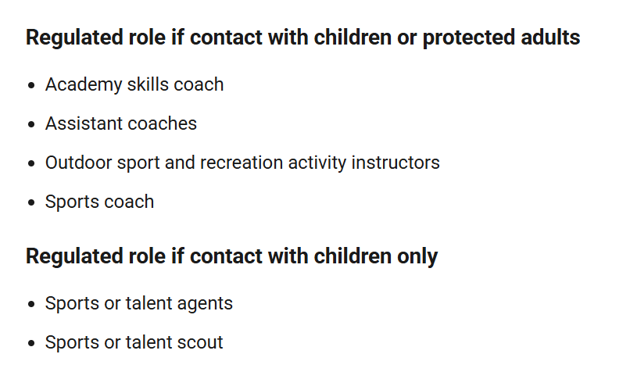
Disclosure Scotland Regulated Role List (Sport)

Slide 7
Regulated Role Assessment
Scottish Rugby / Clubs to review their roles and check if they meet new criteria for requiring a PVG.
Scottish Rugby has defined ambiguous words/phrases to help ensure Scottish Rugby and Clubs are following the same process. Approved by Disclosure Scotland.

Slide 8
Direct and Indirect Contact with Children
2 separate flowcharts to make it as easy as possible for clubs to go through this process
Flowcharts for guidance, every club may have different governance structure / process for how decisions are made that affect children.
Up to each club to make their own decision on which roles will require PVG

Slide 9
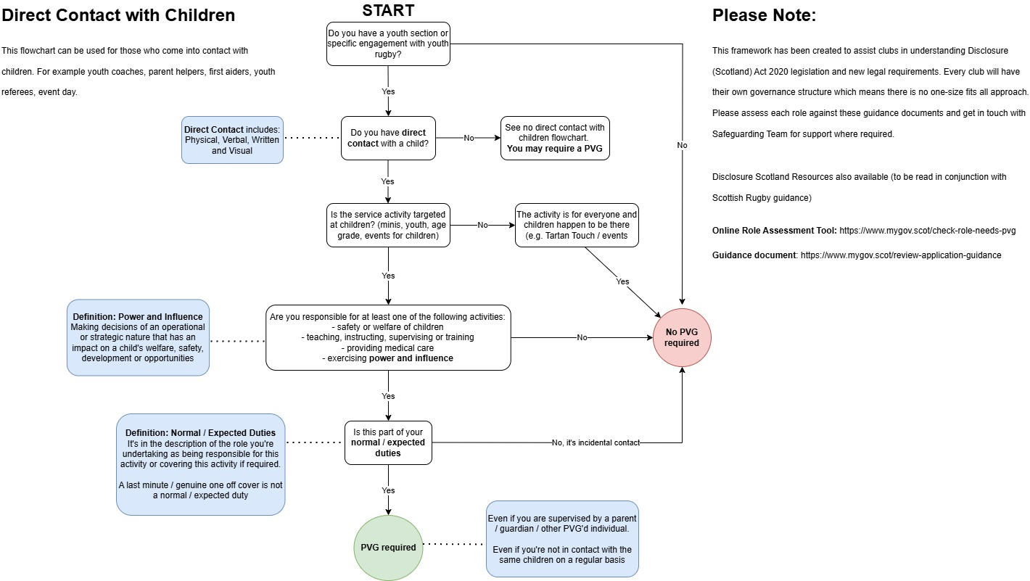

Slide 10
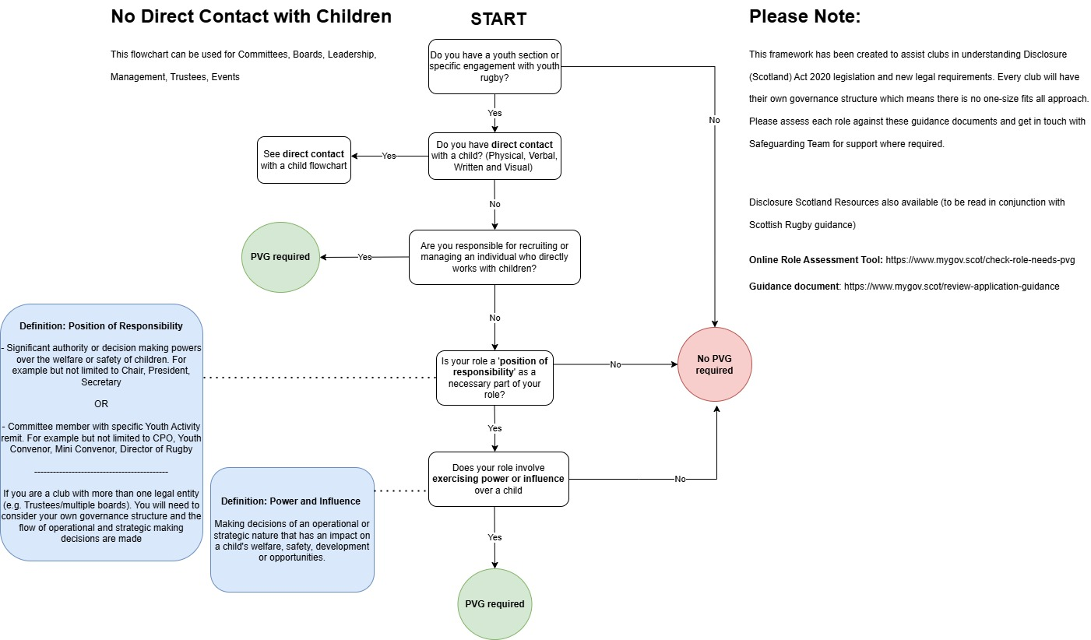

Slide 11
Committee Members
Important to look at each committee role against flowchart
Don’t assume because they sit on a committee that PVG is required
It is also against the law to submit PVGs for those who do not require them
Moving forward - once committee members with no direct contact with children have been elected, submit PVG application ASAP and within 4 weeks of appointment

Slide 12
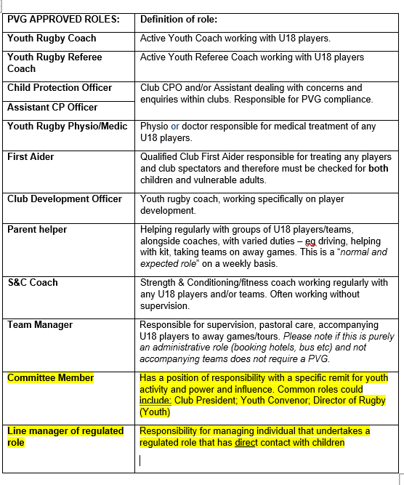
Club Regulated Roles

Slide 13
PVG Coversheet - updates
Includes Line Manager and Committee Member positions
Moved from three applications types:
SRJ (Scheme Record Join)
SRU (Scheme Record Update)
ExSR (Existing Scheme Record)
To two application types
Joining PVG
This is for joining the PVG scheme. It’s also for existing PVG members who want to work with a new vulnerable group
Existing PVG
This is for existing PVG members who are continuing to work with the same vulnerable group on their membership. It adds rugby to their membership.

Slide 14
A role may be assessed as not needing a PVG – if their duties change it could become a Regulated Role. For example, a one off activity becomes a normal duty.
Named locations – Schools, College
Doesn’t matter if the role has a regulated activity. Only that they have the opportunity for unsupervised contact with children

Slide 15
What’s not a Regulated Role
Working with the general public (ie incidental contact)
Activities conducted in the course of a family or personal relationship (e.g. driving)
Working alongside colleagues under the age of 18
School placements for work experience
Match Officials/Referees on field

Slide 16
SCRUMS Analysis
Volunteers at clubs with youth sections, registered on SCRUMS:
2,288 active volunteers
1,346 have Rugby PVG in place
942 no Rugby PVG in place

Slide 17
SCRUMS Analysis
Volunteers at clubs with youth sections with title President, Chair, Secretary, Directory of Ruby, any role that had Youth/Mini/Boys/Girls in the title
987 active volunteers
683 have a Rugby PVG in place
304 no Rugby PVG in place

Slide 18





TIMELINE
28th April
Club CPO / President Webinar
1
2
29th April
Club CPO / President Webinars x2
3
30th April
Club CPO / President Webinar
4
May - June
Clubs to assess roles & submit PVG Coversheets
5
1st July
Grace period over

Slide 19
Main Takeaways
Everyone to be clear on PVG legal requirement
New PVG Roles
Assess roles with your committee and submit any new PVG applications by 30th June
Ongoing support from Safeguarding Team
Supportive and educational
Don’t just PVG everyone!

Slide 20
Questions?

